Slide 2
Highlights of the Project
Transmission file format is as per CMO format and standards.
Authorized stores processing is controlled by pre configured control file.
Settlement file is combined for card types 5(Switch), 7(Visa) and 8 (Access).
Customer instructions are translated from POS values to FMO. Translation is done with new translation table and bin range table for indicator VISA card type.
Processed transactions all card type reports are not combined but similar to stream line processed transactions report (Visa and Access combined in one report and switch transactions are reported separately. Reports will have the new header
Menu screen and validations updated for new option to handle batch Create, recreate and reporting.

Slide 3
Current Flow
COLOR LEGEND
Existing Job/Program
POS Data created from T LOG with 97 String for encrypted credit card information
POS
Existing table
Host IFS (Nu bridge decryption) Used by EODBPOPCC!,EODBPOPCC2, POSB305, POSB310, POSB317, POSB321 and POSB350
EODPEFT
POSFEFT/XXXXYYYY
POSP015BU
EODBVOIDCC
POSP015
POSP016
pOSC105
EODPTMP
POSB105
Copy 15 to 16
EODBPOPCC1 EZBUY (88)
POSP015CP
EODCSALES
EODCRCVFIL
EODBPOPCC2 NON EZBUY(81)
POSB305 Validate
POSP016CP
EODPVOIDCC
LCLSTRCTL
POSC305
EODCBANKG
SWITCH
POSC310
POSCSETLIB
POSP0001
ACCESS
POSP017 FLEXCASH
VISA
POSB310 Data format
CRTCRDTYP=3
POSP050
EZBUY
POSP040
AMEX
POSC317 UK 5,7 or 8
POSP051
FLEXCASH
POSB317
POSP054
POSP052
POSB313 Australia
POSP040
POSC315 Germany
POSP084
POSP053
POSB330 Spain,France
POSB322 UK 5,7,8 RJE
POSP079
POSC320 FTP
POSP056
POSC325 UK cc report
POSP080
POSB320 UK cc report
FTPSTRMGET
PCISFTP
POSP081

Slide 4

Proposed Flow
POS
COLOR LEGEND
POS Data created from T LOG with 97 String for encrypted credit card information
Existing Job/Program
Existing table
Host IFS (Nu bridge decryption) Used by EODBPOPCC!,EODBPOPCC2, POSB305, POSB310, POSB317, POSB321 and POSB350
POSP015BU
POSP016
POSB105
Copy 15 to 16 and 19 to 20 for ....
New Table(s)
POSP016CP
POSFEFT/XXXXYYYY
EODPEFT
New Job/Program
EODBPOPCC1 EZBUY (88)
POSP015
POSB305 Validate
pOSC105
EODPTMP
Modified Job / Program
EODBPOPCC2 NON EZBUY(81)
POSP015CP
POSC305
EODCSALES
EODCRCVFIL
POSBINR
EODPVOIDCC
POSPCUSINS
LCLSTRCTL
EODBVOIDCC
POSP017 FLEXCASH
POSCSETLIB
POSP0001
POSP050
EODCBANKG
SWITCH
POSC310
Change to copy .... store data from POSP016 & POSP016CP to POSP019
POSP040
ACCESS
POSB310 Data format
CRTCRDTYP=3 (SL)
POSP0001
POSP051
POSP054
VISA
POSP052
EZBUY
POSB314 .... Batch
POSP017
POSP040
AMEX
POSC317 5,7 or 8
POSP053
FLEXCASH
....
POSB317
POSP084
POSP079
POSC315 Germany
POSB313 Australia
POSB323 (....)
POSP056
POSP080
POSB330 Spain,France
POSB322 UK 5,7,8 RJE
POSC326
POSP090
POSP081
POSC325 UK cc report
POSC320 FTP
POSC328
POSB322 UK 5,7,8 RJE
POSB323SUM
POSB320 UK cc report
FTPSTRMGET
PCISFTP
POSC327
POSP084H
POSP024H

Slide 5
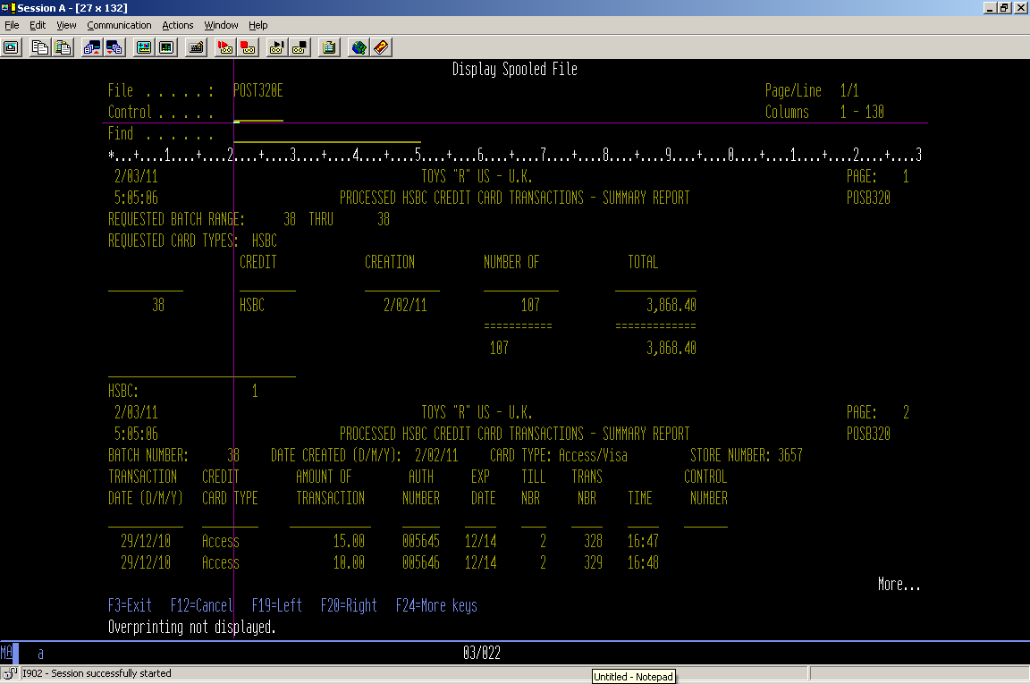
Modified Report for .... Access / Visa Transactions

Slide 6
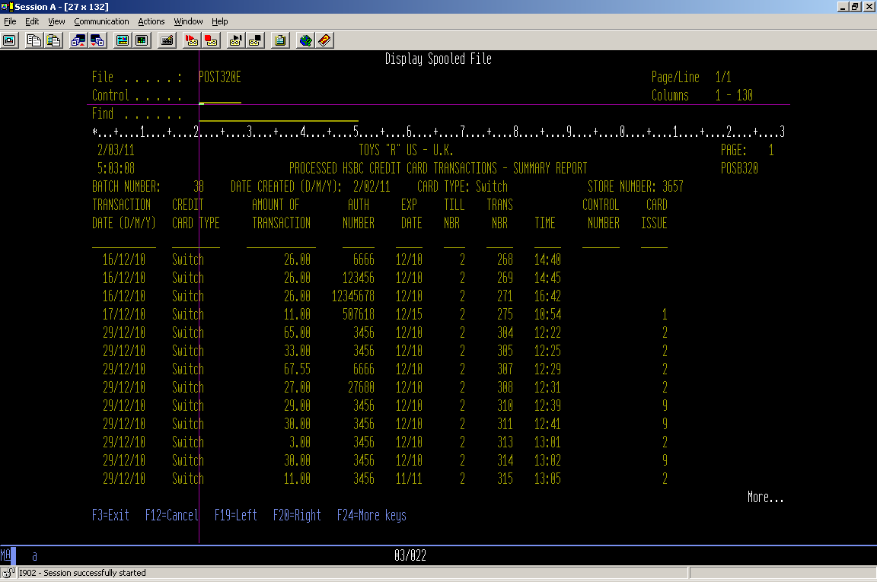
Modified Report for .... Switch Transactions

Slide 7
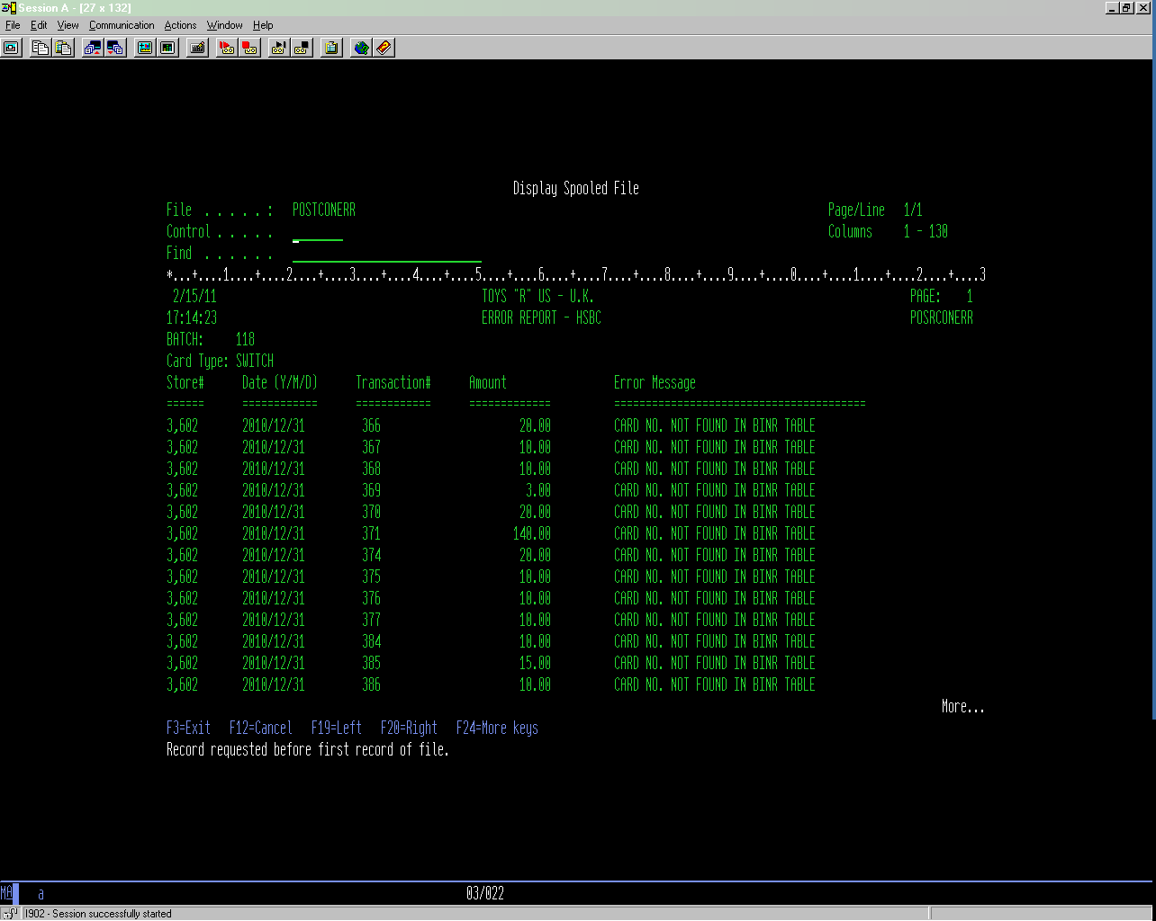
New report of Error transactions failed for Swipe indication Translation.

Slide 8
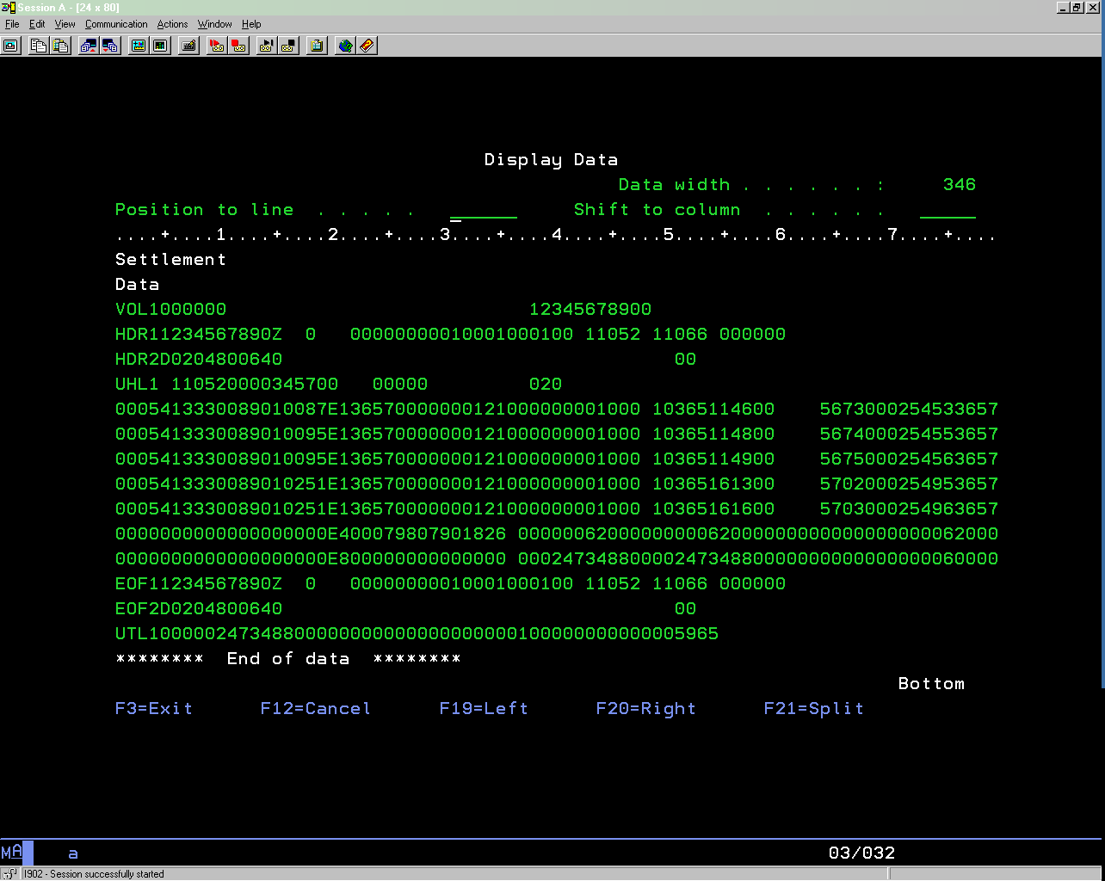
Settlement file

Slide 9
New / Modified Objects
S. No | Object Name | Description | Type | New/Change
1 | POSC310 | Validate Credit Card Data & Create Tape (Changes required to support sftp of new file after completion of credit card processing i.e. 5,7.8). New parameter ‘H’ introduced for .... batch report generation with label changes on report. | CLP | Change
2 | POSC317 | Create Streamline output files | CLP | Change
3 | POSC327 | Send Credit card transaction file via FTP | CLP | New
4 | POSC328 | Receiving Statement files via SFTP | CLP | New
5 | POSC105 | Menu Program ,allows Create and Recreate Batch New parameter introduced for report generation | CLP | Change
6 | POSB314 | To Populate Batch Header File | CBL | New
7 | POSB323 | Create New File for CC Processing (Write transaction records only in POSP084HWK). New flag (CCM ,FFM) added to POSPBINR Refer the file POSPBINR and load the data in array. For conversion create new customer instruction translation table (POSPCUSINS) and generate the settlement for accordingly with construction instructions field translated. | CBL | New
8 | POSP084H | Transmission file | PF | New
9 | POSP084T | Acknowledgement (Statement) File | PF | New
10 | POSP084HWK | Contains transaction records for Cards | PF | New
11 | POSB323SUM | Write Transaction records in POSP084H(Including Header ,Footer and Summary ,net claim) | CBL | New
12 | EODCBANKNG | Changes Required to consolidate Credit Card (5,7,8) | CL | Changes
13 | POST105E | Display file for menu option | DSPF | Change
14 | POSPBINR | New field (CCM,FFM) added to determine where cards are based | PF | Change
15 | POSPCUSINS | New customer instruction conversion table | PF | New
16 | POSRCONERR | New program for generating customer instruction error report | RPG | New
17 | POSPCONERR | Customer Instruction error file | PF | New
18 | POSLCONERR | LF on Customer Instruction error file | LF | New
19 | POSTCONERR | Customer Instruction error report | PRTF | New
20 | POSB320 | Logic added to change the description of Header part in report for .... records | CBL | Change
21 | POSC325 | New parameter introduced for .... report generation | CL | Change
22 | POST320E | Indicator set to display CORE description in the report. | PRTF | Change

